Slide 1
Linear Equations in Linear Algebra
Systems of Linear Equations
Bumhee Cho

Slide 2

A linear equations in the variables
real or complex numbers
coefficients

Slide 3
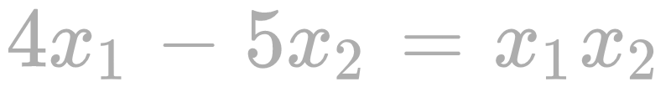
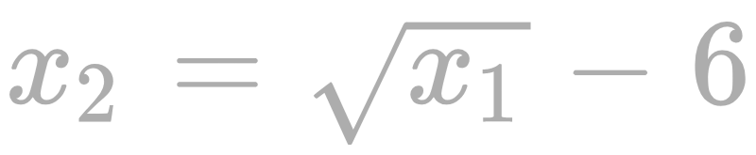

Slide 4
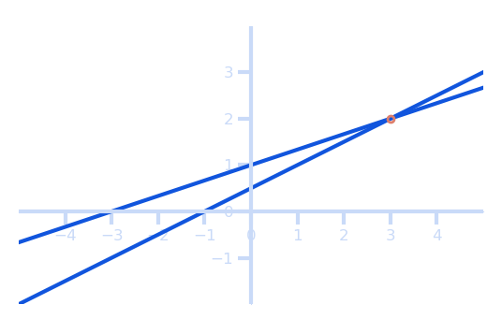
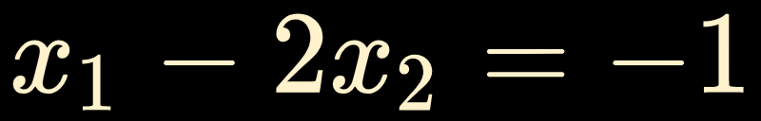
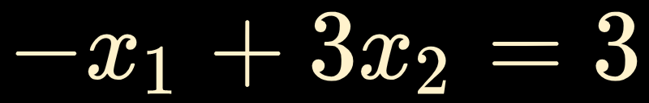
A system of linear equations
a collection of one or more linear equations
(3, 2)
Solution set
The set of all possible solutions of the linear system.
Two linear systems are called equivalent if they have the same solution set.

Slide 5
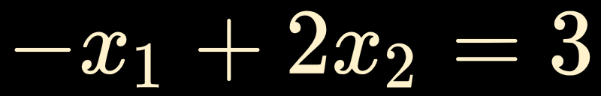
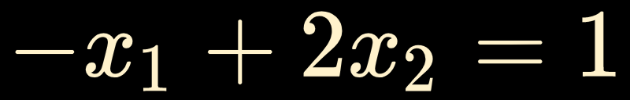
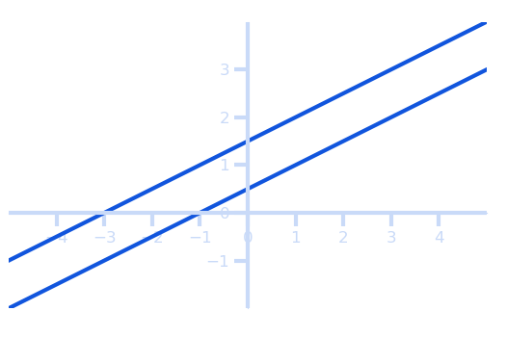
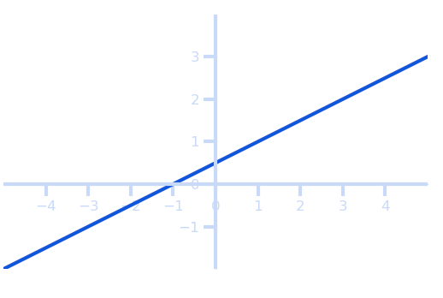
A system of linear equations has either
inconsistent
no solution, or
exactly one solution, or
infinitely many solutions.
no solution, or
consistent

Slide 6
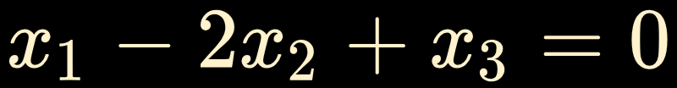
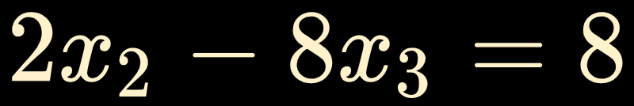
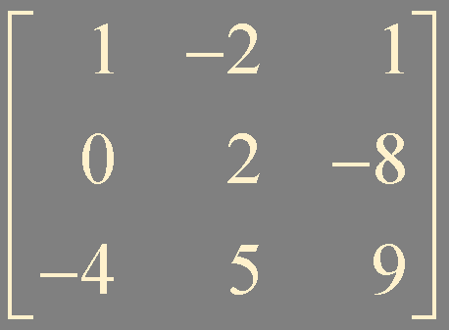
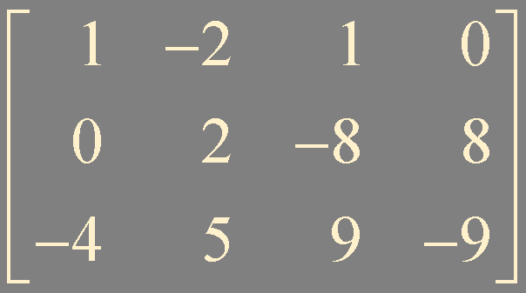


Matrix notation
3 columns (열)
4 columns
3 rows
(행)
3 rows
coefficient matrix ( )
augmented matrix ( )

Slide 7
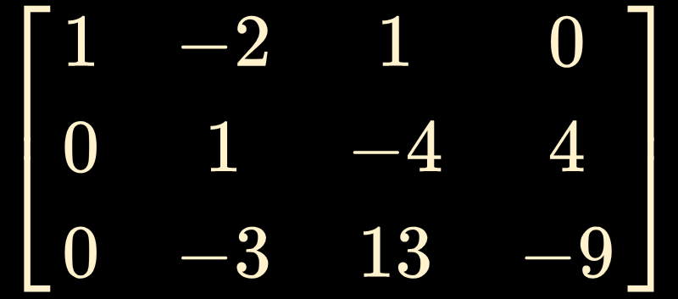




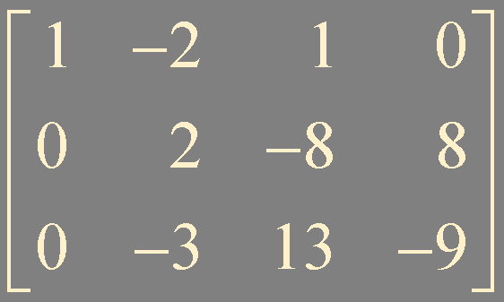
Example1. Solve the following system of linear equations
eq(1)
eq(2)
eq(3)
eq(1)
eq(3)
replacement
eq(3a)
eq(1)
eq(2)
eq(3a)

Slide 8
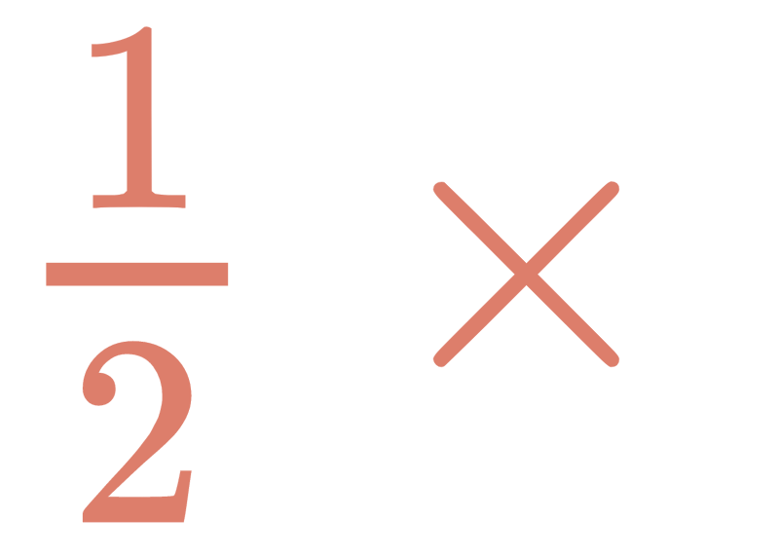
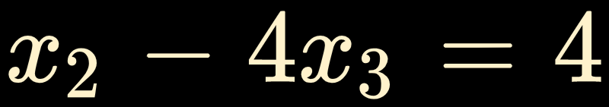
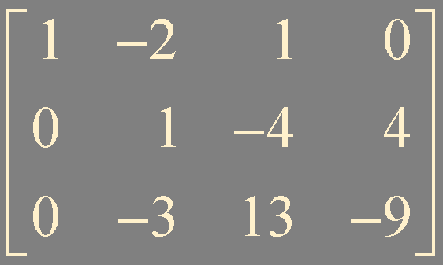
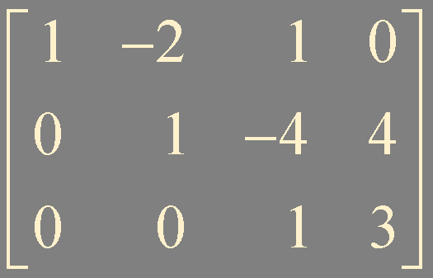
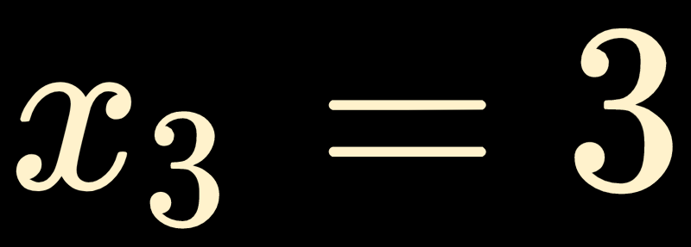
eq(2)
scaling
eq(2a)
eq(1)
eq(2a)
eq(3a)
eq(1)
eq(2a)
eq(3b)

Slide 9

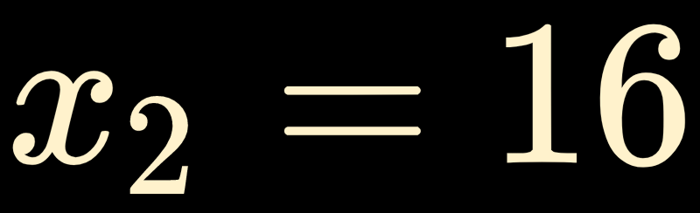
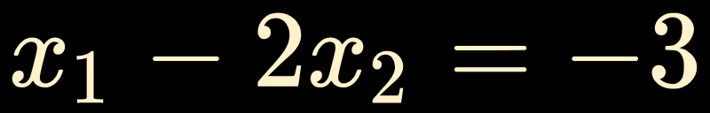
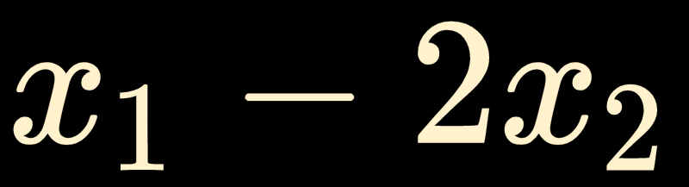

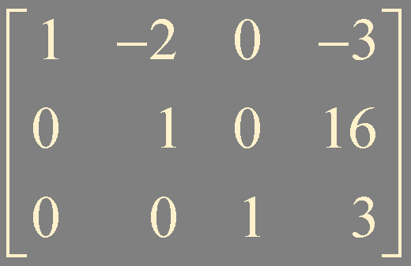
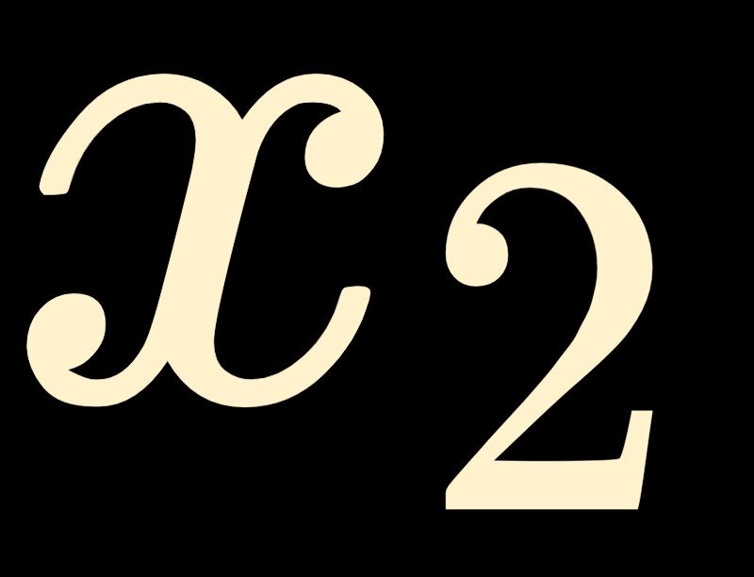

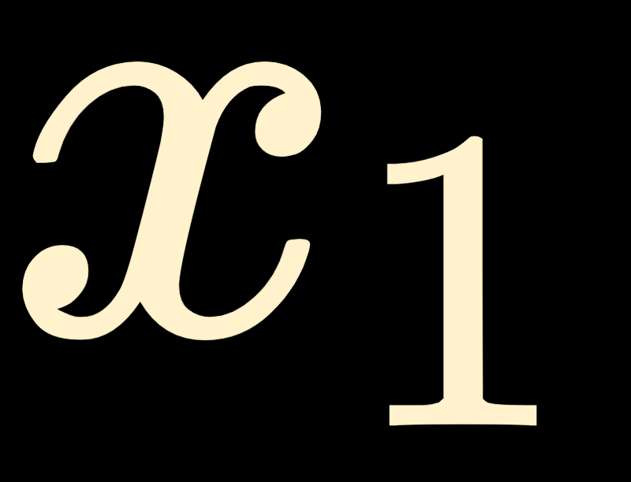

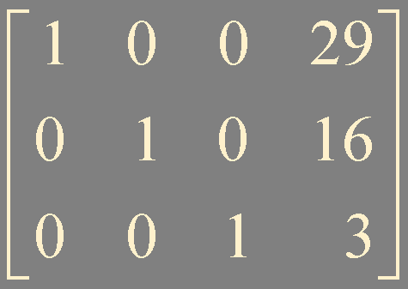
eq(2a)
eq(1)
eq(3b)
eq(3b)
eq(2b)
eq(1a)
eq(1a)
eq(2b)
eq(3b)

Slide 11
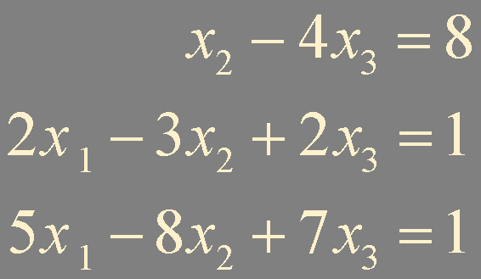
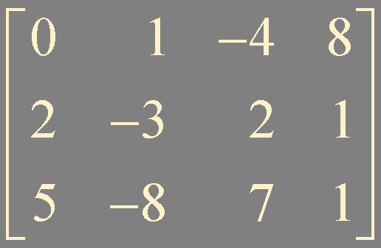
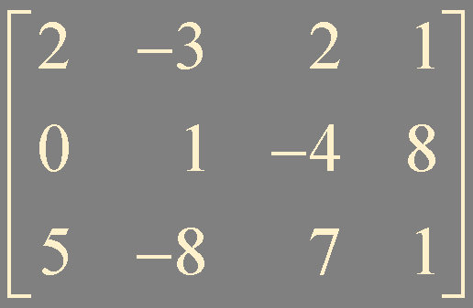
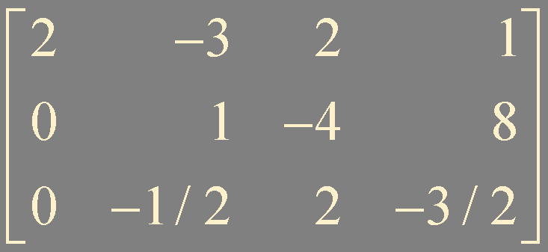
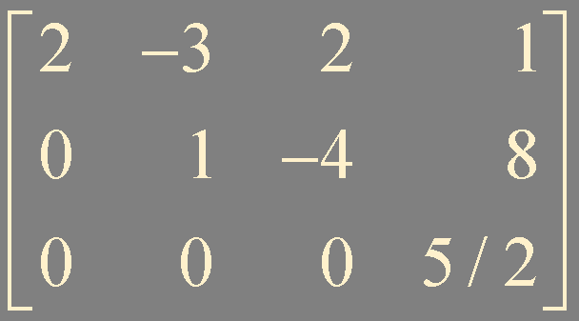
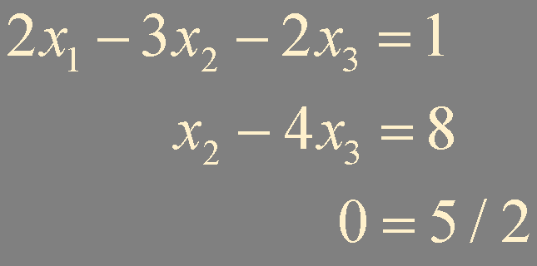
Example2. Solve the following system of linear equations
interchange
inconsistent !

Slide 12
Elementary row operations
replacement
interchange
scaling
We say two matrices are row equivalent if there is a sequence of elementary row operations that transforms one matrix into the other.
If the augmented matrices of two linear systems are row equivalent, then the two systems have the same solution set.

Slide 13
Summary
linear equation
system of linear equations
consistent / inconsistent
elementary row operations: replacement, interchange, and scaling
equivalent / row equivalent

